Slide 1
Digital Transmission
Digital-to-Digital Conversion
Analog-to-Digital Conversion
Transmission Mode

Slide 2

Digital-to-Digital Conversion
Involves three techniques:
  Line coding (always needed), block coding, and scrambling
  Line coding is always needed; block coding and scrambling may or may not be needed.
Line coding: the process of converting digital data to digital signals

Slide 3

Signal Element and Data Element
Data elements are what we need to send; signal elements are what we can send.

Slide 4
Data Rate Versus Signal Rate
Data rate defines the number of data elements (bits) sent in 1s. Unit is bps.
Signal rate is the number of signal elements sent in 1s. Unit is baud.
Data rate = bit rate; signal rate = pulse rate, modulation rate, baud rate.
Increasing the data rate increases the speed of transmission; decreasing the signal rate decreases the bandwidth requirement.
Relationship between data rate and signal rate:
S = c x N x 1/r
where N is the date rate; c is the case factor, S is the number of signal elements; r is the number of data elements carried by each signal element.

Slide 5
The bandwidth of a digital signal is theoretically infinite, but many of the components have such a small amplitude that they can be ignored. The effective bandwidth is finite.
The bandwidth is proportional to the signal rate (baud rate).
The minimum bandwidth: B_{min} = c x N x 1/r
The maximum data rate: N_{max} = 1/c x B x r

Slide 6
Design Consideration for Line Coding Scheme
Baseline wandering
  A long string of 0s or 1s can cause a drift in the baseline.
  A good line coding scheme needs to prevent baseline wandering.
DC components
  DC or low frequencies cannot pass a transformer or telephone line (below 200 Hz)
  We need a scheme with no DC component.
Self-synchronization
- a self-synchronizing digital signal includes timing information in the data being transmitted.
Built-in error detection – desirable
Immunity to noise and interference – desirable
Complexity – a complex scheme is more costly

Slide 7

Lack of Synchronization

Slide 8

Line Coding Schemes

Slide 9

Unipolar Scheme
One polarity: one level of signal voltage
Unipolar NRZ (Non-Return-to-Zero) is simple, but
  DC components: Cannot travel through telephone wire or transformer
  Synchronization : Consecutive 0’s and 1’s are hard to be synchronized → Separate line for a clock pulse
  Normalized power is double that for polar NRZ

Slide 10
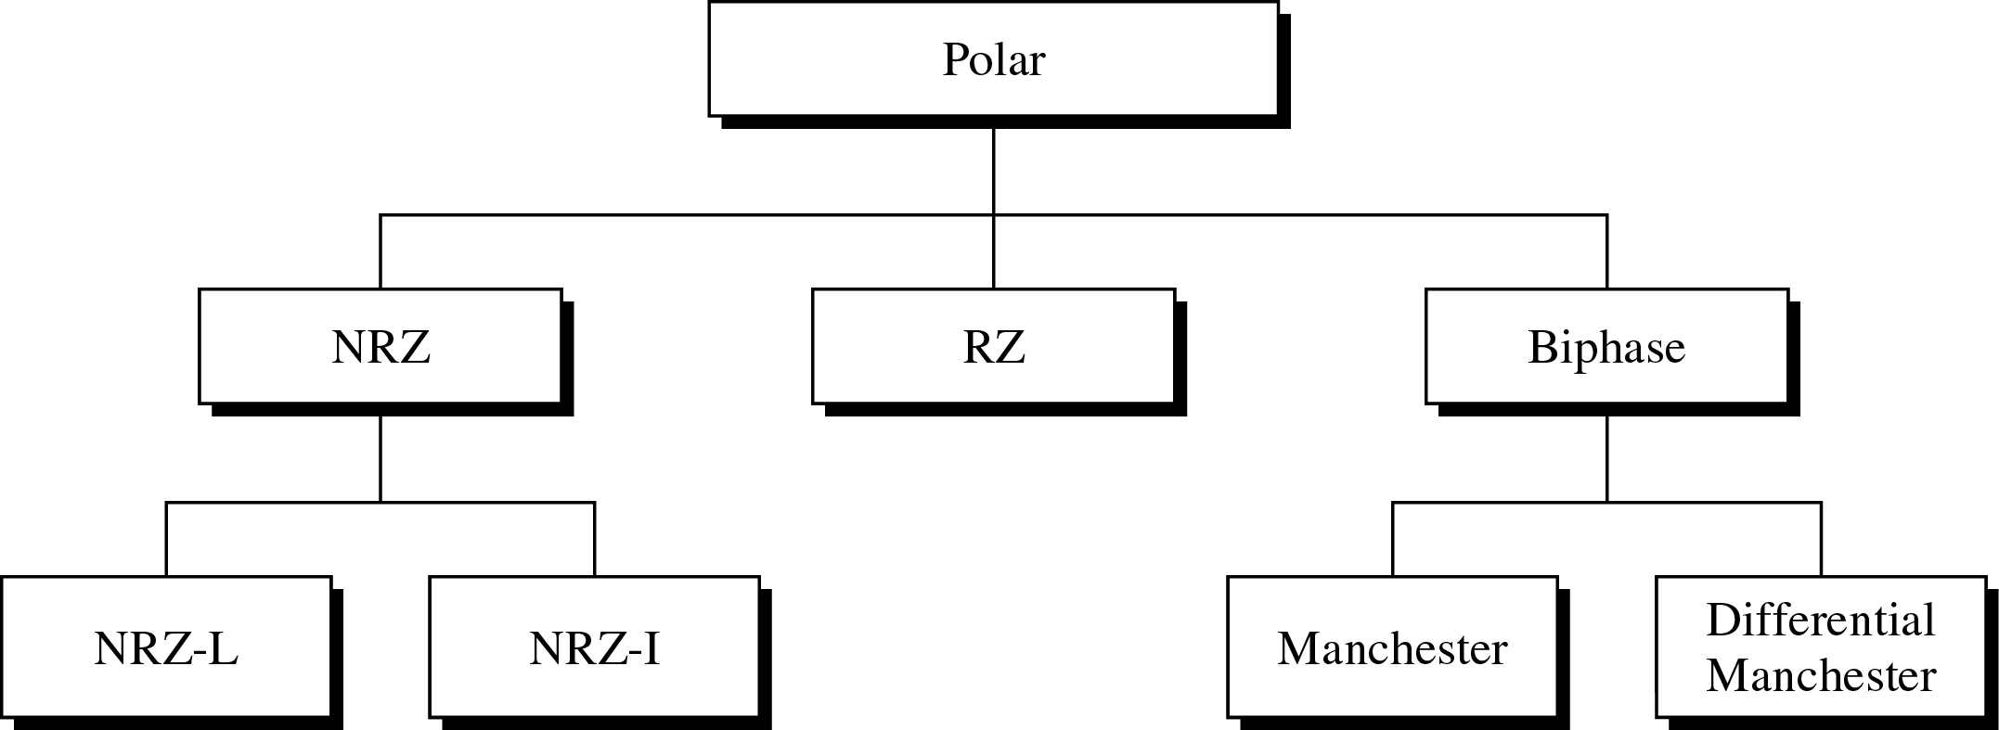
Polar Scheme
Two polarity: two levels of voltage
Problem of DC component is alleviated (NRZ,RZ) or eliminated (Biphase)

Slide 11

Polar NRZ
NRZ-L (Non Return to Zero-Level)
  Level of the voltage determines the value of the bit
NRZ-I (Non Return to Zero-Invert)
  Inversion or the lack of inversion determines the value of the bit

Slide 12
Polar NRZ: NRZ-L and NRZ-I
Baseline wandering problem
  Both, but NRZ-L is twice severe
Synchronization Problem
  Both, but NRZ-L is more serious
NRZ-L and NRZ-I both have an average signal rate of N/2 Bd
Both have a DC component problem

Slide 13

RZ
Provides synchronization for consecutive 0s/1s
Signal changes during each bit
Three values (+, -, 0) are used
  Bit 1: positive-to-zero transition, bit 0: negative-to-zero transition

Slide 14
Biphase
Combination of RZ and NRZ-L ideas
Signal transition at the middle of the bit is used for synchronization
Manchester
  Used for Ethernet LAN
  Bit 1: negative-to-positive transition
  Bit 0: positive-to-negative transition
Differential Manchester
  Used for Token-ring LAN
  Bit 1: no transition at the beginning of a bit
  Bit 0: transition at the beginning of a bit

Slide 15

Polar Biphase
Minimum bandwidth is 2 times that of NRZ

Slide 16

Bipolar Scheme
Three levels of voltage, called “multilevel binary”
Bit 0: zero voltage, bit 1: alternating +1/-1
  (Note) In RZ, zero voltage has no meaning
AMI (Alternate Mark Inversion) and pseudoternary
  Alternative to NRZ with the same signal rate and no DC component problem

Slide 17
Multilevel Scheme
To increase the number of bits per baud by encoding a pattern of m data elements into a pattern of n signal elements
In mBnL(where m is the length of the binary pattern, B means binary data, n is the length of the signal pattern, and L is the no. of levels in the signaling) schemes, a pattern of m data elements is encoded as a pattern of n signal elements in which 2^{m} ≤ L^{n}
2B1Q (two binary, one quaternary)
8B6T (eight binary, six ternary)
4D-PAM5 (four-dimensional five-level pulse amplitude modulation)

Slide 18

2B1Q
Data rate 2 times faster
Receiver has to discern four different thresholds
Used for DSL

Slide 19

8B6T
Used with 100Base-4T cable
Encode a pattern of 8 bits as a pattern of 6 (three-levels) signal elements
222 redundant signal element = 3⁶(478 among 729) - 2⁸(256), for synchronization and error detection.
The average signal rate is theoretically, S_{ave} = 1/2 x N x 6/8; in practice the minimum bandwidth is very close to 6N/8

Slide 20

4D-PAM5: for Gigabit LAN

Slide 21

Multiline Transmission: MLT-3
The signal rate for MLT-3 is one-fourth the bit rate
MLT-3 when we need to send 100Mbps on a copper wire that cannot support more than 32MHz

Slide 22
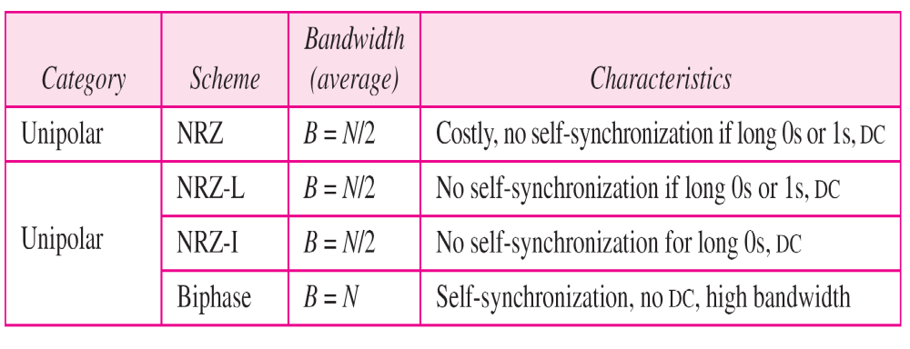

Summary of Line Coding Schemes

Slide 23

Block Coding
Block coding is normally referred to as mB/nB coding; it replaces each m-bit group with an n-bit group

Slide 24

4B/5B
Solve the synchronization problem of NRZ-I
20% increase the signal rate of NRZ-I (Biphase scheme has the signal rate of 2 times that of NRZ-I
Still DC component problem

Slide 25
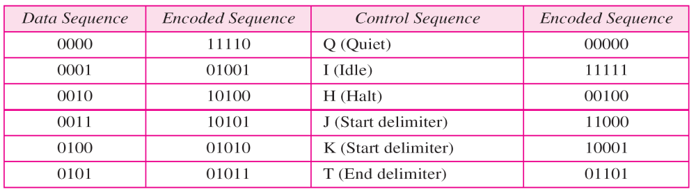

4B/5B Mapping Codes

Slide 26

8B/10B
2¹⁰ – 2⁸ = 768 redundant groups used for disparity checking and error detection

Slide 27

Scrambling
Biphase : not suitable for long distance communication due to its wide bandwidth requirement
Combination of block coding and NRZ: not suitable for long distance encoding due to its DC component problem
Bipolar AMI: synchronization problem → Scrambling

Slide 28

B8ZS
Commonly used in North America
Updated version of AMI with synchronization
Substitutes eight consecutive zeros with 000VB0VB
V denotes “violation”, B denotes “bipolar”

Slide 29

HDB3
High-density bipolar 3-zero
Commonly used outside of North America
HDB3 substitutes four consecutive zeros with 000V or B00V depending on the number of nonzero pulses after the last substitution

Slide 30
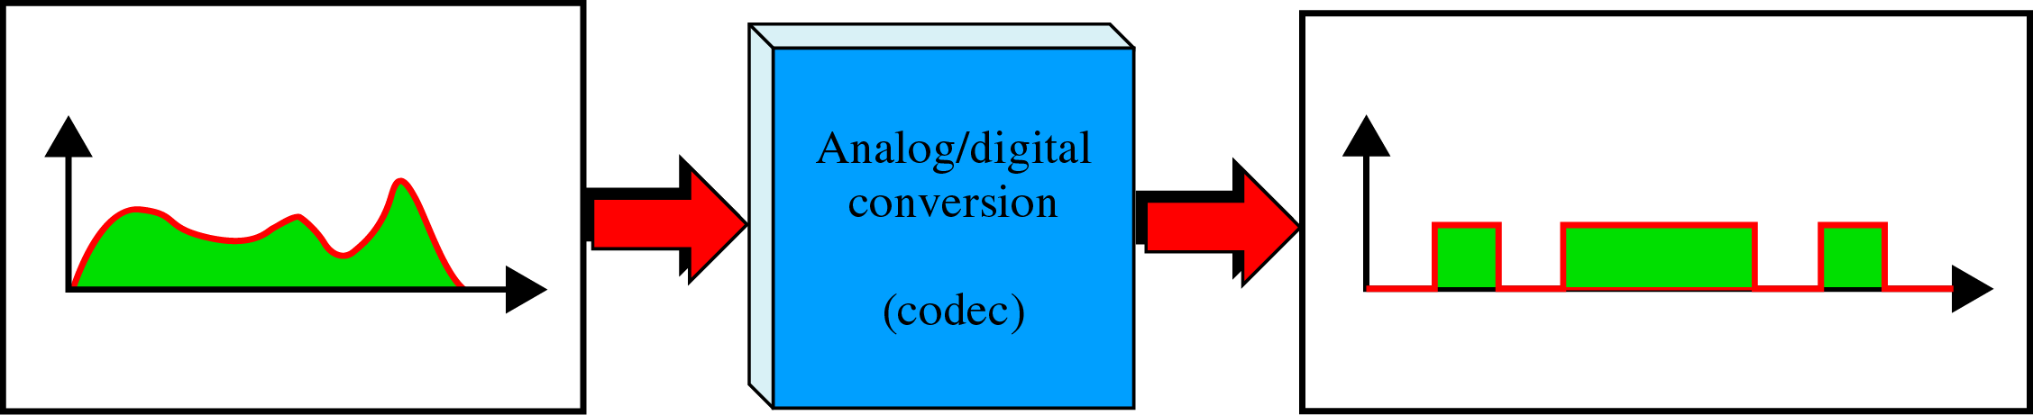
Sampling: Analog-to-Digital Conversion
Analog information (e.g., voice) → digital signal (e.g., 10001011…)
Codec(Coder/Decoder): A/D converter

Slide 31
PCM
Pulse Code Modulation
Three processes
  The analog signal is sampled
  The sampled signal is quantized
  The quantized values are encoded as streams of bits
Sampling: PAM (Pulse amplitude Modulation)
  According to the Nyquist theorem, the sampling rate must be at least 2 times the highest frequency contained in the signal.

Slide 32

Components of PCM Encoder

Slide 33

Different Sampling Methods for PCM

Slide 34

Nyquist Sampling Rate

Slide 35

Sampling Rate

Slide 36

Quantization

Slide 37
Quantization
Quantization level (L)
Quantization error : depending on L (or n_{b} )
  SNR_{dB} = 6.02n_{b} + 1.76 dB
Nonuniform quantization:
  Companding and expanding
  Effectively reduce the SNR_{dB}

Slide 38

Original Signal Recovery: PCM Decoder

Slide 39
PCM Bandwidth
The min. bandwidth of a line-encoded signal
  B_{min} = c x N x 1/r = c x n_{b} x f_{s} x 1/r
= c x n_{b} x 2 x B_{analog} x 1/r
= n_{b} x B_{analog} where 1/r = 1, c = 1/2
Max. data rate of a channel
  N_{max} = 2 x B x log₂L bps
Min. required bandwidth
  B_{min} = N/(2 x log₂L) Hz

Slide 40

Delta Modulation
To reduce the complexity of PCM

Slide 41

Delta Modulation Components

Slide 42

Delta Demodulation Components

Slide 43

Transmission Modes
The transmission of binary data across a link can be accomplished in either parallel or serial mode.
In parallel mode, multiple bits are sent with each clock tick, whereas in serial, 1 bit is sent with each clock tick.

Slide 44
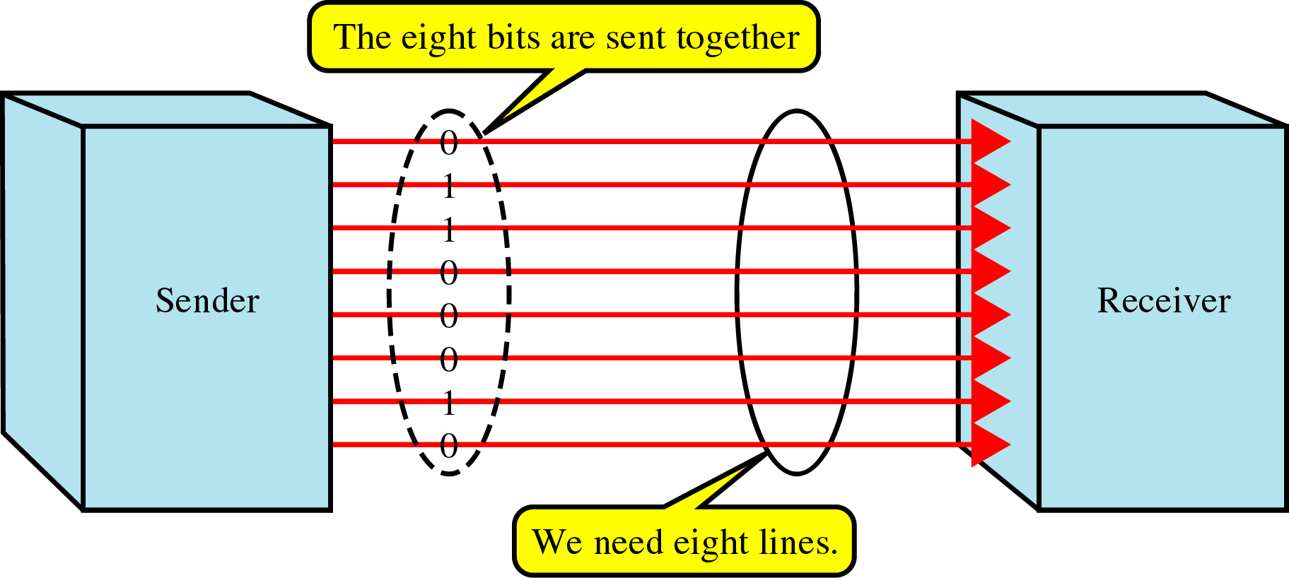
Parallel Transmission
Binary data, consisting 0s and 1s, may be organized into groups of n bits each.
In parallel transmission, we can sent data n bits at a time.
Use n wires to send n bits at one time.
Advantage: speed
Disadvantage: cost ⇒ Limited to short distances

Slide 45
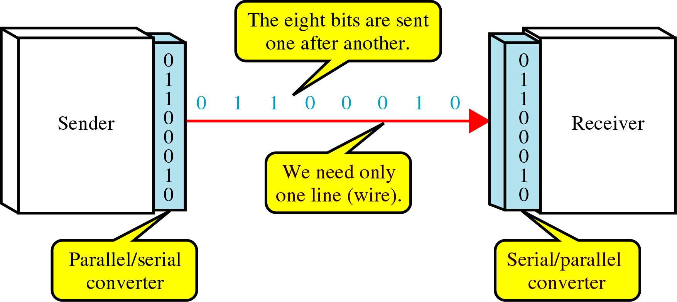
Serial Transmission
In serial transmission one bit follows another; so we need only one communication channel.
Advantage: reduced cost
Since communication within devices is parallel, parallel/serial converter is required at the interface between the sender and the line
Three ways: asynchronous, synchronous, or isochronous

Slide 46
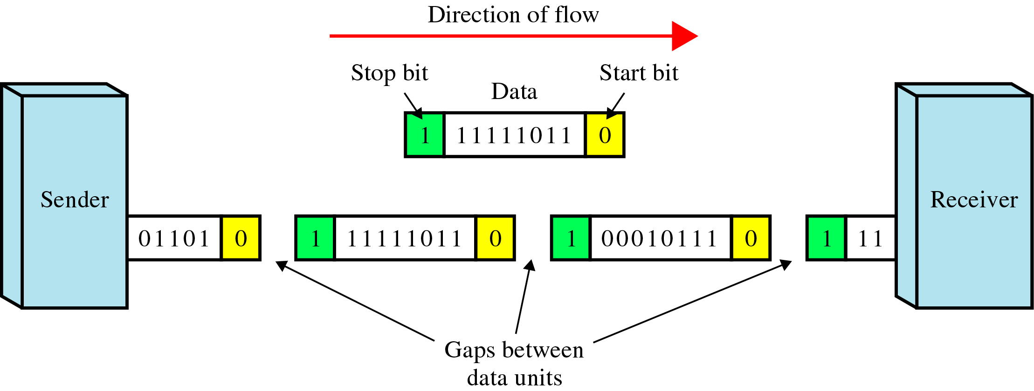
Asynchronous Transmission
Asynchronous transmission is so named because the timing of a signal is unimportant. Instead, information is received and translated by agreed upon patterns. Each pattern, or group of bits, is sent along the link as a unit.
Use start bit (0) and stop bits (1s)
A gap between each byte: idle state or stop bits
It means asynchronous at byte level
Must still be synchronized at bit level
Good for low-speed communications (connection of keyboard to a computer.)

Slide 47
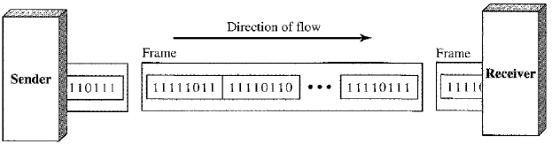
Synchronous Transmission
Bit stream is combined into longer “frames”, which may contain multiple bytes.
We send bits one after another without start or stop bits or gaps. It is the responsibility of the receiver to group the bits.
Special sequence of 1/0 between frames: No gap
Timing is important in midstream
Byte synchronization in the data link layer
Advantage: speed ⇒ high-speed transmission

Slide 48
Isochronous Transmission

